Slide 1
Lab 1

Slide 2
The plan
Getting you up to speed with R
R and Rstudio check-up
Interactive intro to R via Swirl
Getting you up to speed with the exercise format
R MarkDown
Exercise!

Slide 3
Checking up R and Rstudio
Do you all have it?
Does it work?

Slide 4
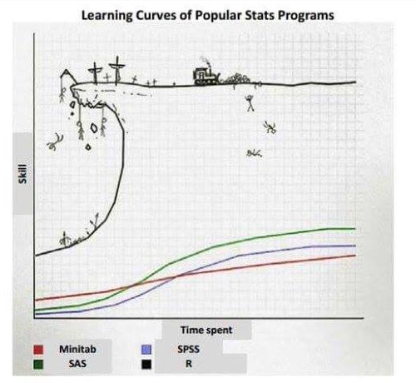
R and other statistical programs

Slide 5
Be on that bulldozer!
R is a programming language developed for doing statistics
Free and open source!
Scriptable (reproducible and reusable)
Googlable (much much help online)
New methods developed ALL the time!
All analyses with 1 line of code!
Truly!
Though the data pre-processing is much longer…

Slide 6
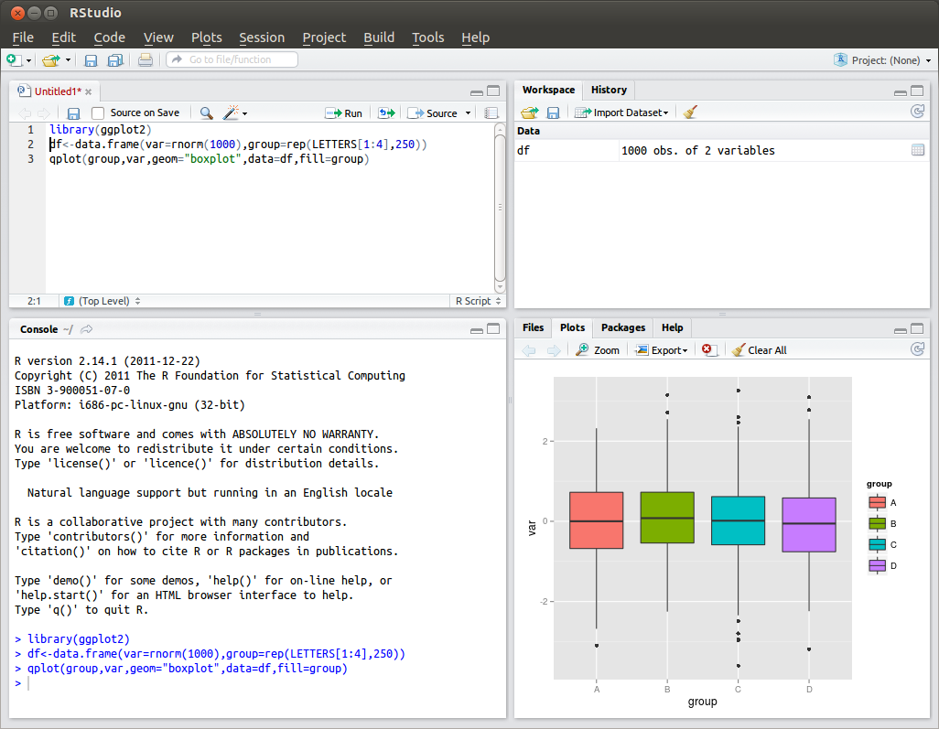
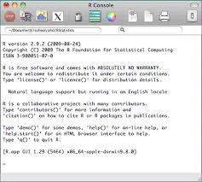
Rstudio: a nice interface to keep it all in place (data, code, output, plots)

Slide 7
Ready to start?

Slide 8
Intro to R via Swirl
Let’s do a quick intro to R programming:
Open RStudio
install.packages("swirl")
library(“swirl”)
install_from_swirl(”R Programming Alt")
swirl()
Questions?
NB: More advanced users can try
install_from_swirl(”Open Intro”)

Slide 9
How was that?

Slide 10
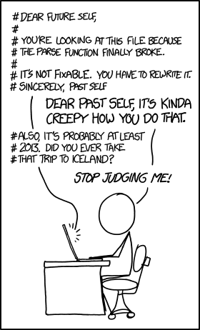
Let’s move to the next level!

Slide 11
Real example I
Running the same analysis many times
Predicting autism from voice
Predicting schizophrenia from voice
Predicting depression from voice
Predicting bipolar disorder from voice
….
Write 1 script, apply to new data

Slide 12
Real example II
Finding a mistake in the data
Spend a few days understanding how to run a complicated analysis (predicting social relationships from laughs)
Send a happy mail to collaborators: “Look at what I found!”
2 weeks later get a response: “Sorry, we mislabeled the data! Could you re-run it on the new corrected data?”

Slide 13
Real example III
Understanding your code
Write a script analysing the laughter data in 2013 and send the results to co-authors
Get an email in 2015: “Could you write a paragraph for the paper explaining exactly what you have done?”
Desperation follows (I had to write a new script to understand what I had done and kept getting different results).

Slide 14
Lessons learned
Always write your code as a script
Re-usable and modifiable
Always carefully document your code
Comments, comments, comments
R Markdown

Slide 15
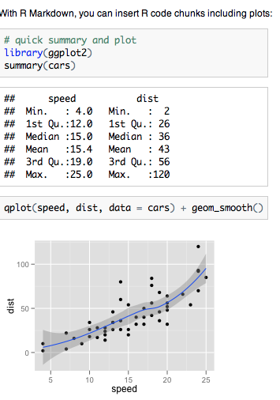

R MarkDown

Slide 16
LET’S HAVE A LOOK

Slide 17
Check the Day1Exercise1 Rmd file
It solves the first steps of Josh’s exercise
White background is text
Grey background is code
To see what the code does:
One line at a time: position your cursor on the line, push “Run”
The full document: push Knit html

Slide 18
Structure of the exercises
Instructions in the white part, to be solved in the grey part
Push on knit and you have a ready fancy report!

Slide 19
A cheat sheet for R Markdown
http://shiny.rstudio.com/images/rm-cheatsheet.pdf.zip

